Slide 1

AUTOMATIC PLANT WATERING SYSTEM
DEPARTMENT OF ELECTRICAL AND ELECTRONICS ENGINEERING
20EEE78A - Project Phase 1
Semester 03 (2021-2022)
Presented by
1NH20EE048 | KAMALESH BADOLA
1NH20EE056 | KUSHAL NAIK K
1NH20EE057 | LAVA KUMAR M N
Guide | Ms.Deepa V Bolanavar
Date | 04 . 12 . 2021

Slide 2

INTRODUCTION
This project “Automatic Plant Watering System Circuit” immediately waters the plant once the soil turns dry. By adding timer circuits and other components.
A proper usage of irrigation system is very important because the main reason is the shortage of land reserved water due to lack of rain, unplanned use of water as a result large amounts of water goes waste.
For this reason, we use this AUTOMATIC PLANT WATERING SYSTEM, and this system is very useful in all climatic conditions.

Slide 3

LITERATURE SURVEY
Title of the paper | Author & Year of Publication | Source & Year of Publication | Outcome of the paper
Automatic Irrigation System on Sensing Soil Moisture Content Automatic Plant Watering System Design and Implementation of automatic plant watering system | R.Vagulabranan1, M.Karthikeyan2, V.Sasikala3 Abhishek Gupta, Shailesh Kumawat,Shubham Garg Archana P, Priya R | International Research Journal of Engineering and Technology (2016) (IEEE)- 2016 (IEEE)- 2016 | Detail introduction of automated irrigation system and soil moisture. illustrates the implementation of an automatic plant watering system using IC 555 The paper includes design and the working of the relay circuit and the activation of the pump.

Slide 4

OBJECTIVE OF THE PROJECT
The aim of the project is to design and develop an automatic plant watering system.

Slide 5

BLOCK DIAGRAM
PROBE
Soil sensor
IC 555
SOIL
Dry soil – flow of water
Water pump
Wet soil – No flow of water

Slide 6
COMPONENTS REQUIRED
IC 555 timer
VARIABLE RESISTOR (10K)
SOIL SENSOR
DC WATER PUMP (9V)
RELAY (5V)
BATTERY -2 (9V)
BREAD BOARD
CONNECTING WIRES

Slide 7
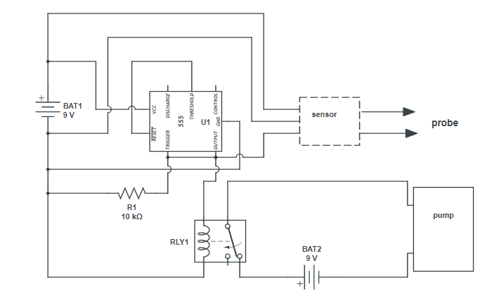
CIRCUIT DIAGRAM

Slide 8
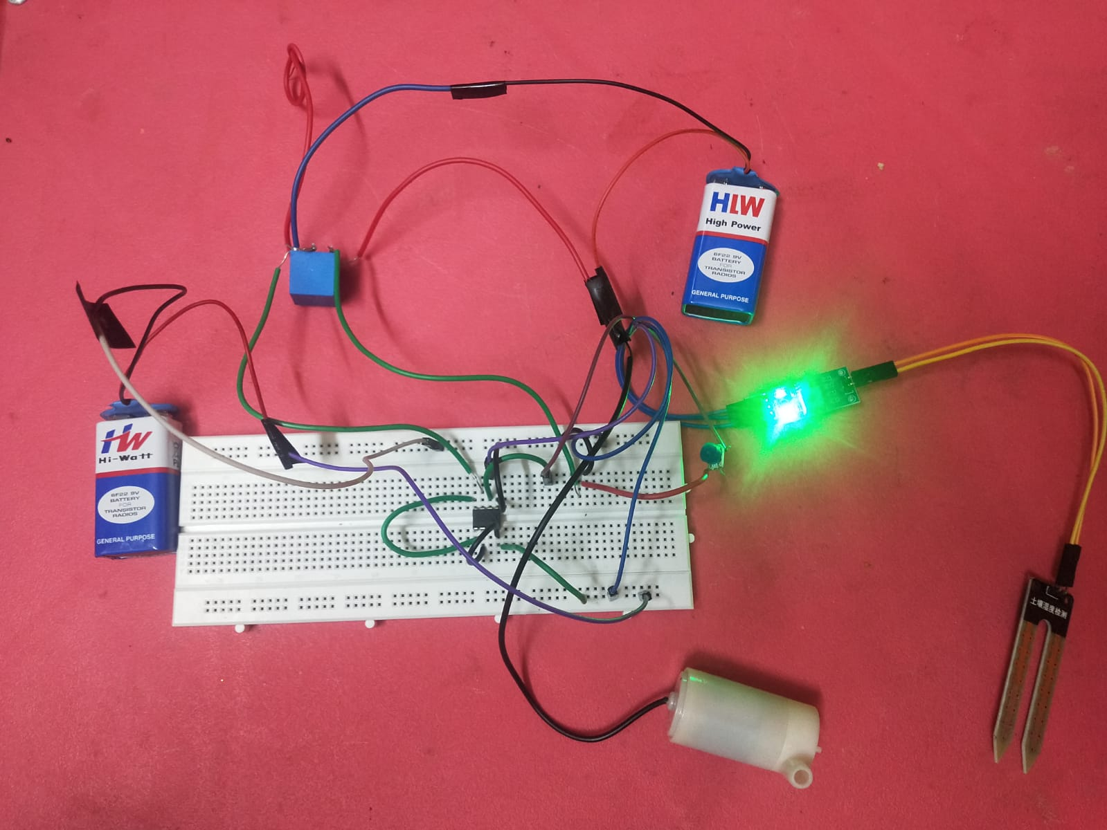
HARDWARE PICTURE

Slide 9

ADVANTAGES
SAVES TIME: Your system will do all the watering for you.
SAVES WATER: An automatic system uses less water than watering by hand.
SAVES MONEY: Your water bills will be lower and your plants will live longer.
REST EASY: assurance of quality, value, and performance.

Slide 10
LIMITATIONS
.
Method cannot be used with high iron content water because emitters become clogged.
Maintenance is required to keep system going.
Chewing on tubing from insects and rodents can cause water leaks.

Slide 11

APPLICATIONS
Used to measure the loss of moisture in the soil over time due to evaporation and intake.
Automatic Watering To The Plant .

Slide 12
RESULTS
It was observed that the proposed methodology controls the moisture content of the soil of cultivated land. The motor automatically start pumping water if the soil is dry and stops when the moisture content of the soil is maintained as required.

Slide 13
REFERENCES
International Research Journal of Engineering and Technology (IRJET) e-ISSN: 2395 -0056 Volume: 03 Issue: 03 | Mar-2016 Automatic Irrigation System on Sensing Soil Moisture Content R.Vagulabranan1, M.Karthikeyan2, V.Sasikala3
Abhishek Gupta, Shailesh Kumawat,Shubham Garg,“Automatic Plant
Watering System”,IJIR,Jaipur, India,2016 (IEEE)
Archana P, Priya R, “Designand Implementationofautomatic plant watering system”,IJAEGT,Coimbatore, India,2016(IEEE)

Slide 14
THANK YOU

